Slide 1


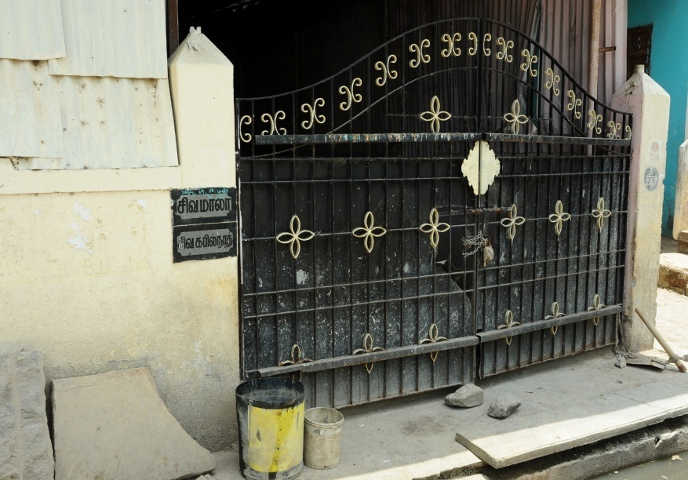
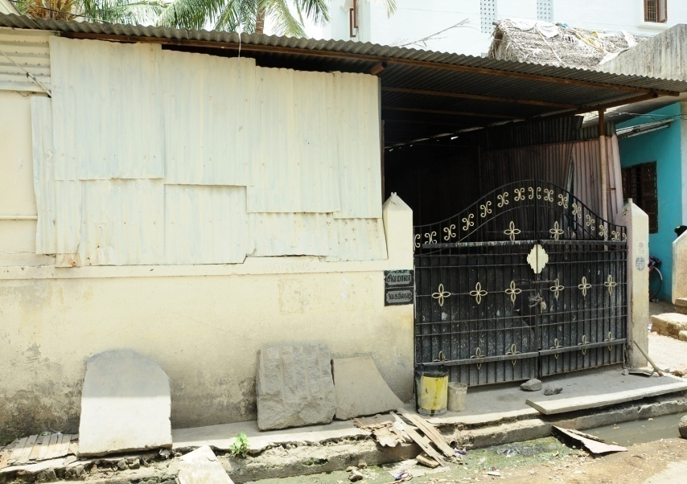
RESIDENTIAL FLAT
RESB - 151
Location of Property | PERUMBAKKAM , CHENNAI
Total area of land | 1225. Sqft
Constructed area | GROUND FLOOR 544 sq ft
Year of construction | 2004
Current market value | 46.00 lakhs

Slide 2
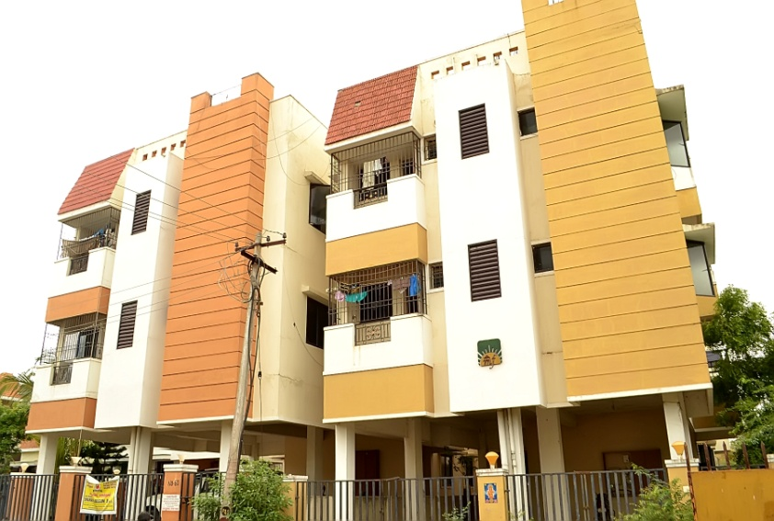
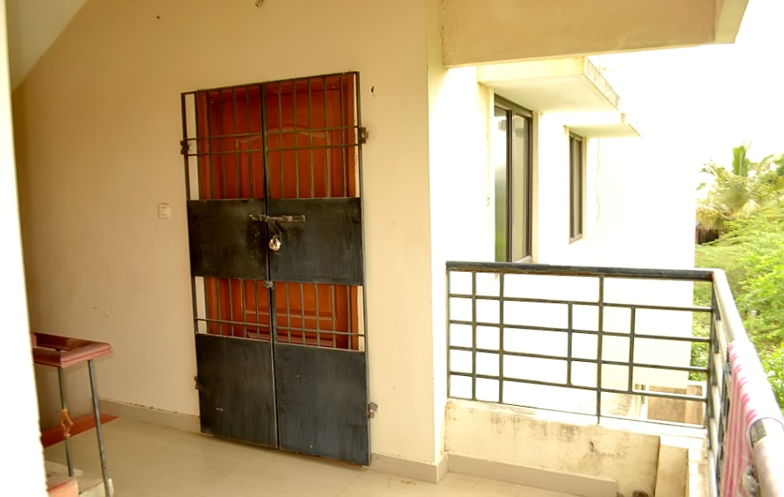
RESIDENTIAL FLAT
RESB - 152
Location of Property | GUDUVANCHERRY
Total area of land | 2621. Sqft
Constructed area | FIRST FLOOR 980 Sq ft WITH UDS of 450 Sq ft
Year of construction | 2014
Current market value | 23.27 lakhs

Slide 3
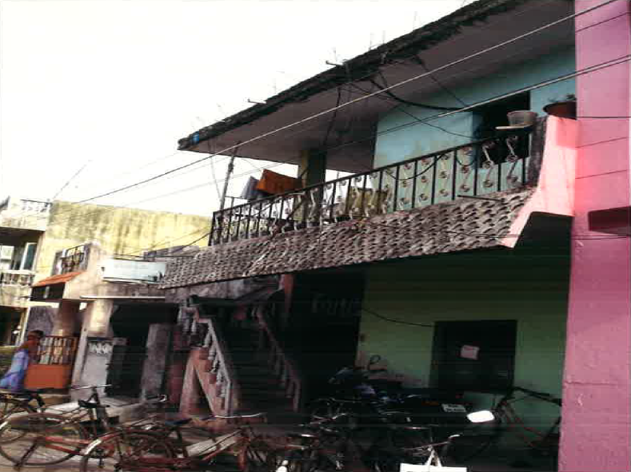
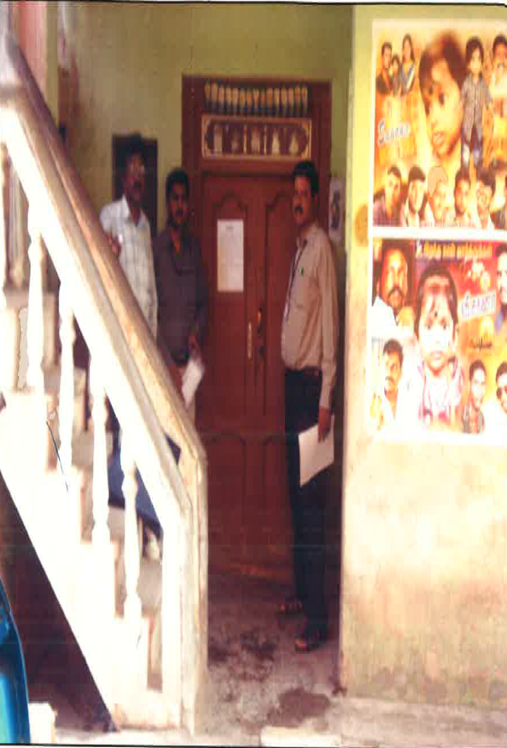
RESIDENTIAL LAND & BUILDING
RESB - 153
Location of Property | KOSAPALAYAM,PONDICHERRY
Total area of land | 1320 sq.ft
Constructed area | --
Year of construction | --
Current market value | Rs.33.00 Lacs

Slide 4
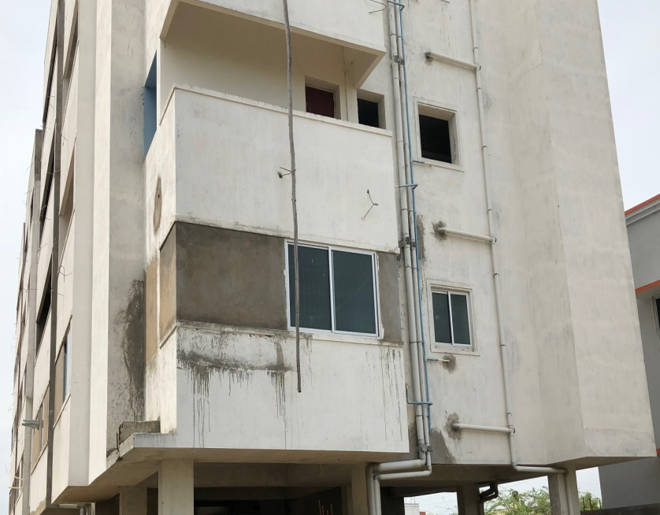
RESIDENTIAL FLAT
RESB - 154
Location of Property | AYYENCHERRY, CHENGALPATTU
Total area of land | 7070. Sqft
Constructed area | SECOND FLOOR 975 .Sq ft WITH UDS of 409. Sq ft
Year of construction | UNDER CONSTRUCTION
Current market value | 36.00 lakhs

Slide 5
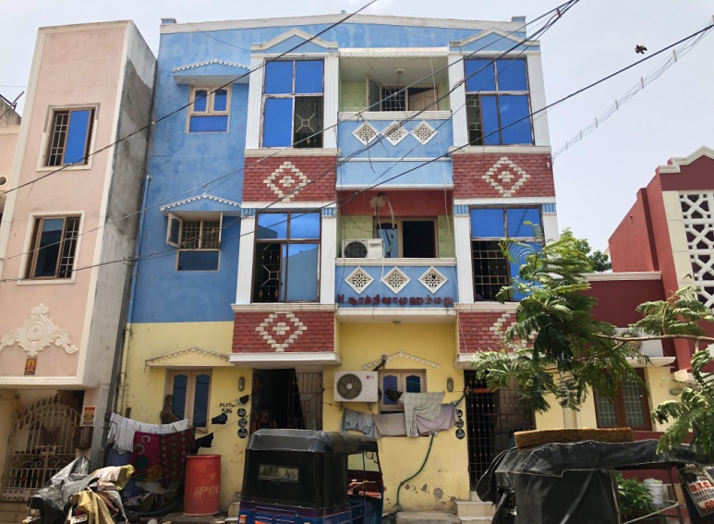
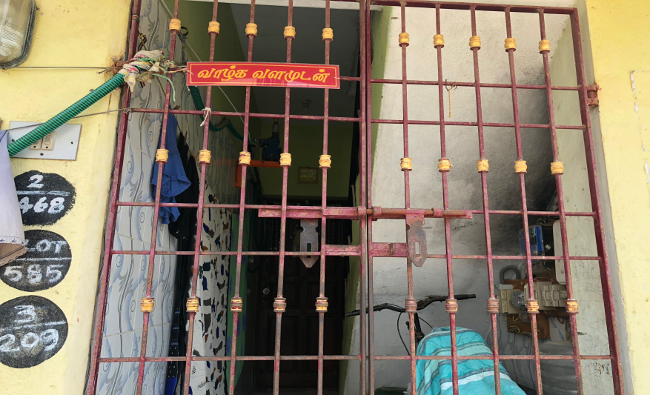
RESIDENTIAL FLAT
RESB - 155
Location of Property | TNHB - SITALAPAKKAM
Total area of land | 690. Sqft
Constructed area | 1028 SQFT- GROUND FLOOR 514 SQ FT + FIRST FLOOR 514 SQFT
Year of construction | 2008
Current market value | 55.70 lakhs

Slide 6
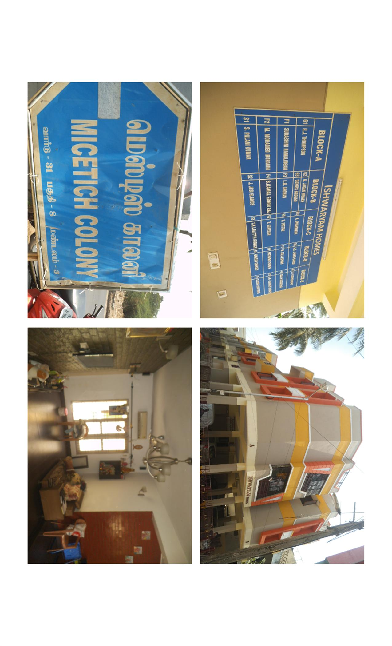
RESIDENTIAL VACANT LAND
RESB - 156
Location of Property | MTH ROAD AMBATTUR CHENNAI
Total area of land | 2195.Sq ft
Constructed area | FIRST FLOOR 1140. Sq ft WITH 682. Sq ft UDS
Year of construction | 2010
Current market value | 69.00 lakhs

Slide 7
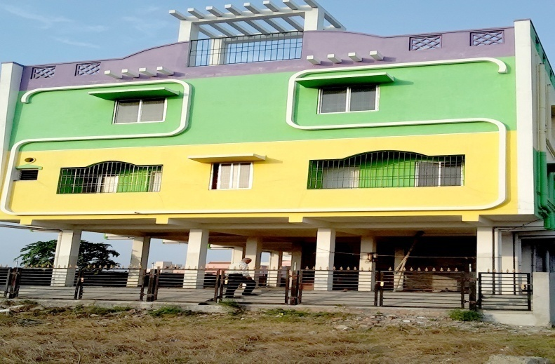
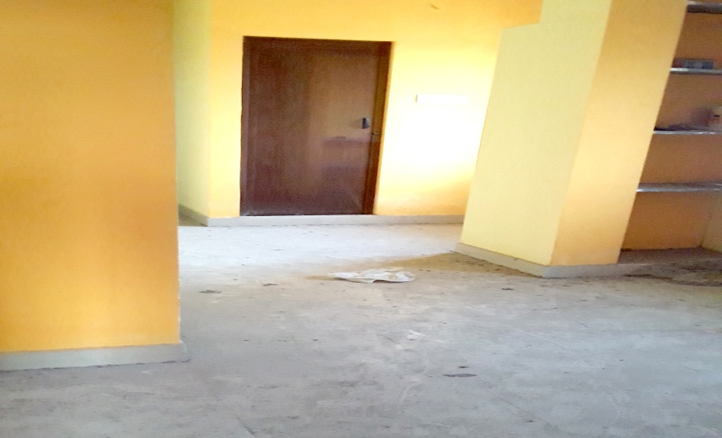
RESIDENTIAL FLAT
RESB - 157
Location of Property | VARADHARAJAPURAM CHENNAI
Total area of land
Constructed area | FIRST FLOOR 740 Sq Ft with, UDS of 419Sq ft
Year of construction | 2016
Current market value | 25.80 lakhs

Slide 8
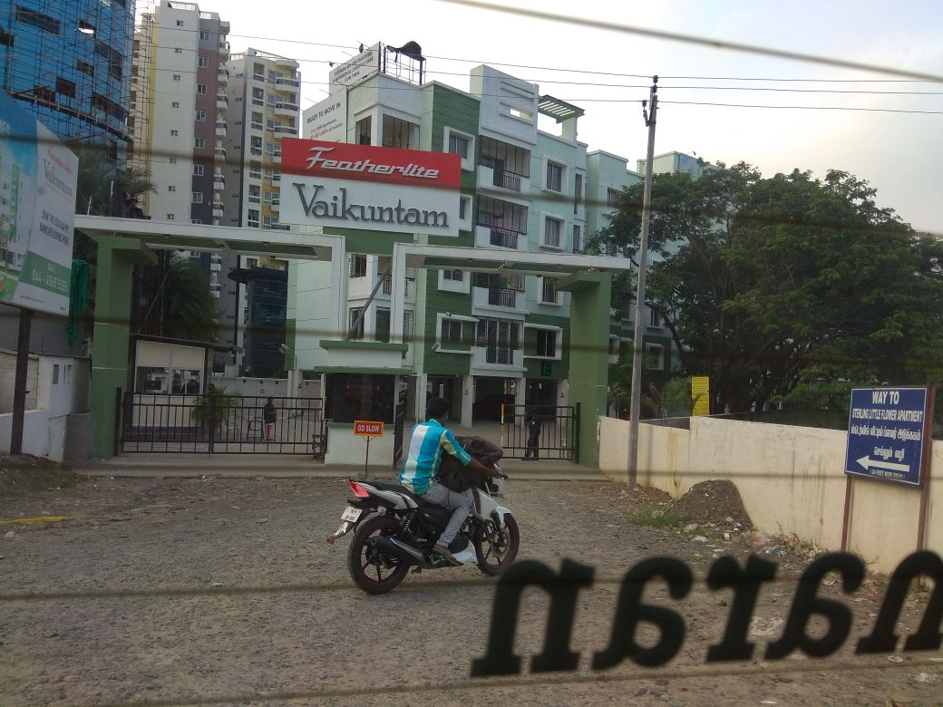
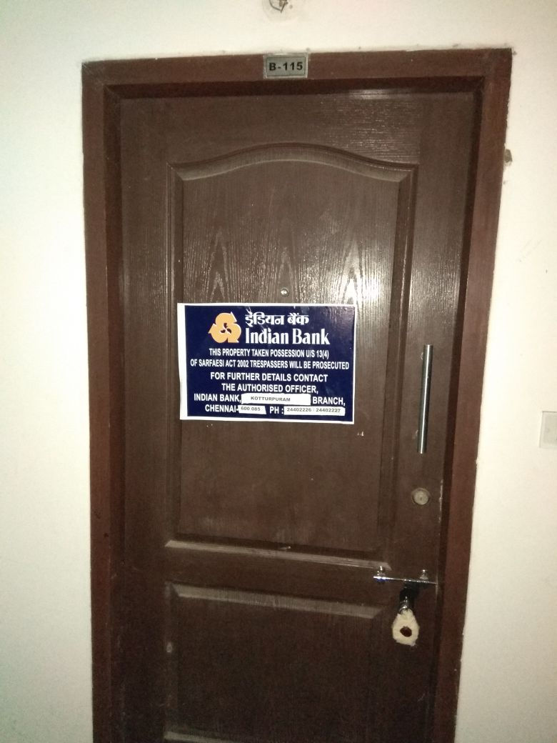
RESIDENTIAL FLAT
RESB - 158
Location of Property | NANDIVARAM, URAPPAKAM
Total area of land
Constructed area | FIRST FLOOR B BLOCK1317 Sq Ft with, UDS of 816 Sq ft
Year of construction | 2012
Current market value | 57.70 lakhs

Slide 9
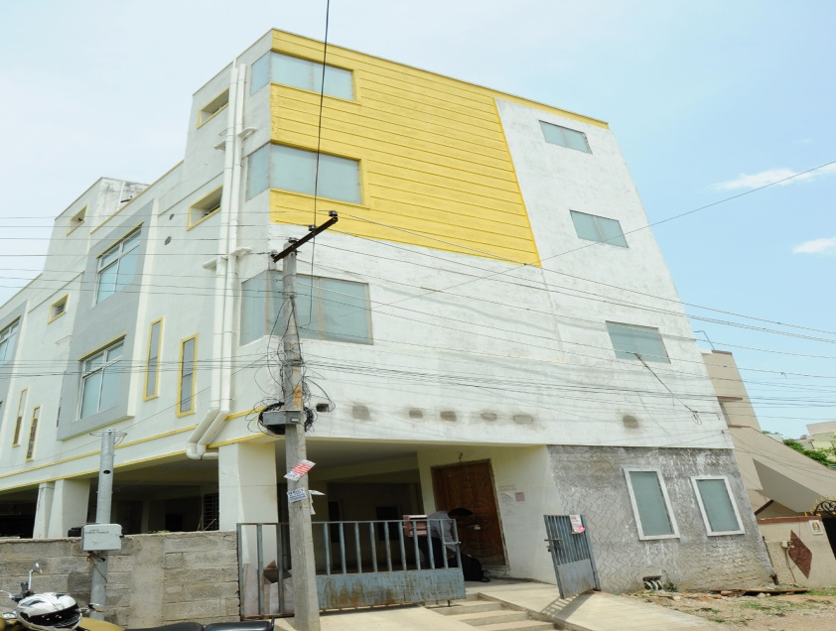
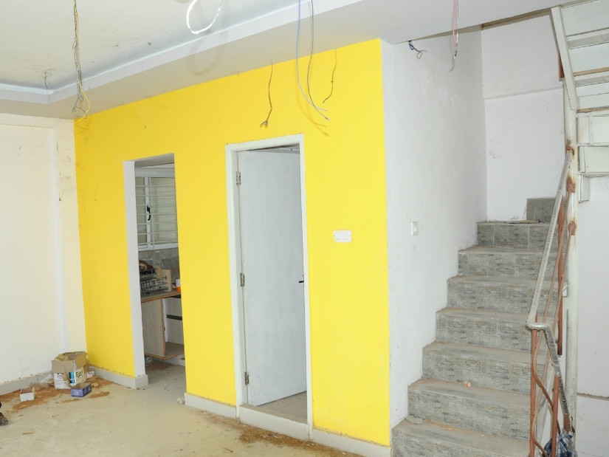
RESIDENTIAL FLAT
RESB - 159
Location of Property | ANAKAPUTHUIR CHENNAI
Total area of land | 1250 Sq ft
Constructed area | FIRST FLOOR 858 Sq Ft with, UDS of 417 Sq ft
Year of construction | 2018
Current market value | 31.54 lakhs

Slide 10
RESIDENTIAL FLAT
RESB - 160
Location of Property | OMR KAZHIPATTUR VILLAGE
Total area of land | 534536 Sft
Constructed area | SECOND FLOOR TOWER 2084 Sq Ft with, UDS of 694 Sq ft
Year of construction | 2016
Current market value | 95.28 lakhs

Slide 11
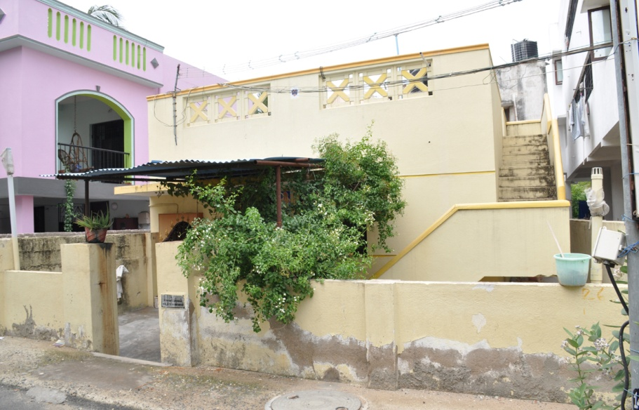
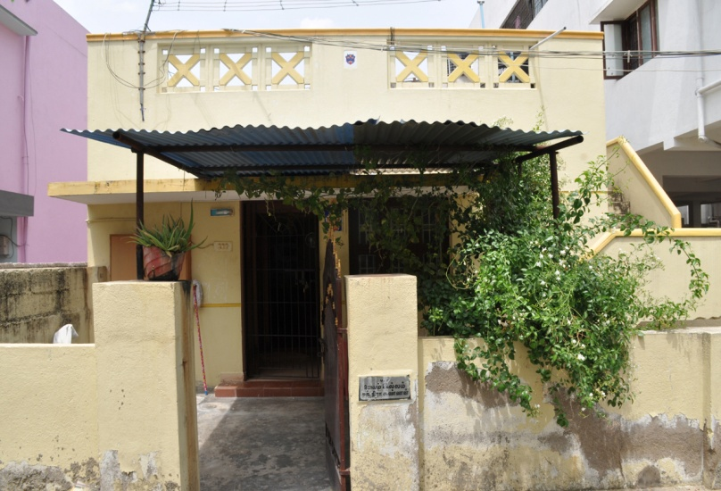
RESIDENTIAL FLAT
RESB - 161
Location of Property | MADIPAKKAM CHENNAI
Total area of land | 1125 Sq ft
Constructed area | 613 Sq ft
Year of construction | 2004
Current market value | 50.05 lakhs

Slide 12
RESIDENTIAL FLAT
RESB - 162
Location of Property | VELACHERY CHENNAI
Total area of land | 7200 Sq ft
Constructed area | F1- FIRST FLOOR 810 Sq ft WITH UDS OF 456 Sft
Year of construction | 2000
Current market value | 55.00 lakhs

Slide 13
RESIDENTIAL FLAT
RESB - 163
Location of Property | CHITALAPAKKAM TAMBARAM
Total area of land | 2803 Sft
Constructed area | F1- SECOND FLOOR 850 Sq ft WITH UDS OF 400 Sft
Year of construction | 2013
Current market value | 42.00 lakhs

Slide 14
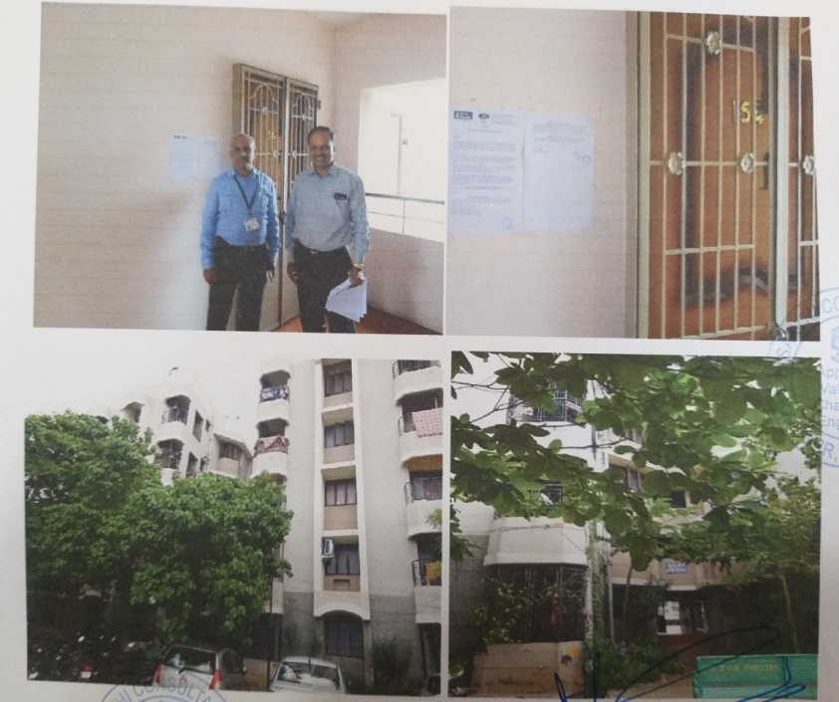
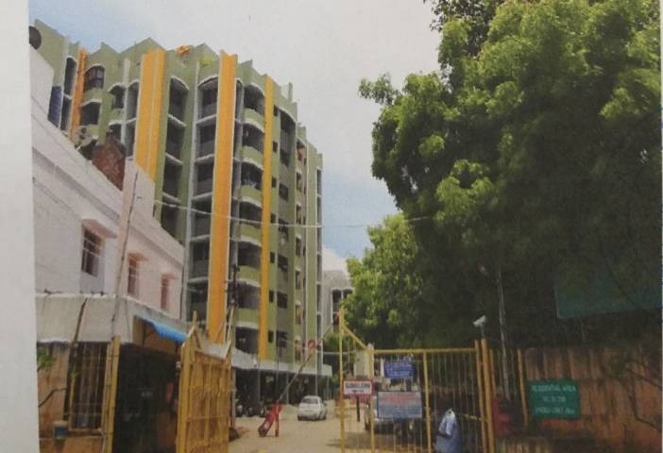
RESIDENTIAL BUILDING
RESB - 164
Location of Property | MADURAI
Total area of land | 239 sq.ft (UDS)
Constructed area | 1300 sq.ft
Year of construction | 2006
Current market value | Rs. 61.75 lacs

Slide 15
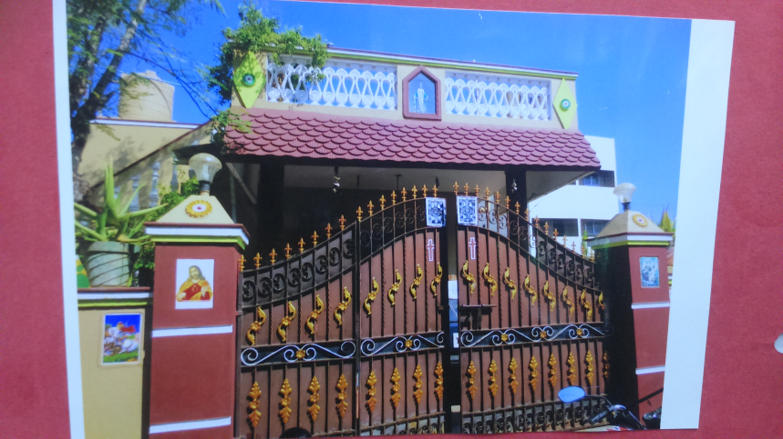
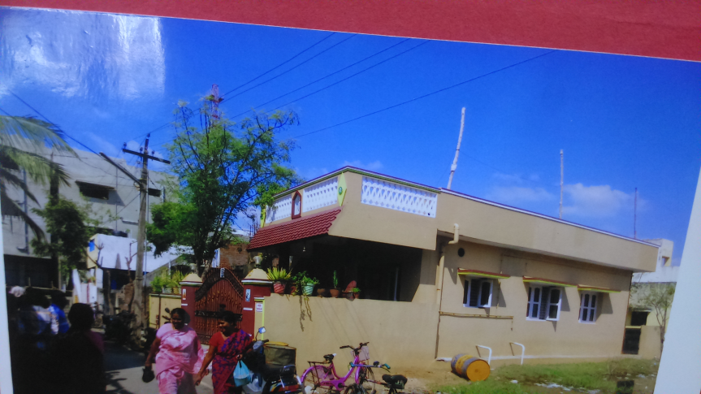
RESIDENTIAL LAND AND BUILDING
RSEB - 165
Location of Property | PALLIKARNI, CHENNAI
Total area of land | 739 sq.fts+107 sq.fts porch
Constructed area | 739 sq.fts
Year of construction | 2009
Current market value | Rs. 59.82 lacs

Slide 16
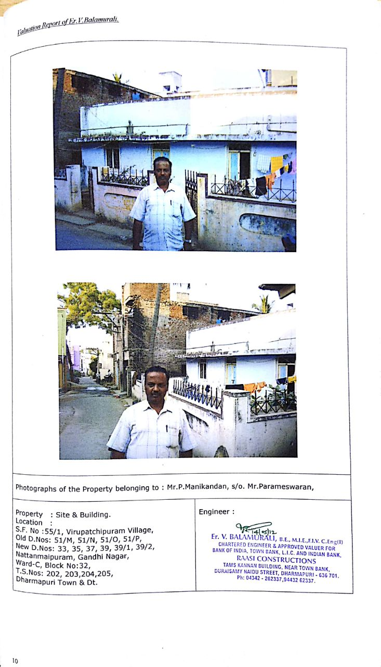
RESIDENTIAL LAND AND BUILDING
RSEB - 166
Location of Property | VIRUPATCHIPURAM, DHARMAPURI
Total area of land | 2784 sq.fts
Constructed area | 2784 sq.fts
Year of construction | 2012
Current market value | Rs. 99.08 lacs

Slide 17
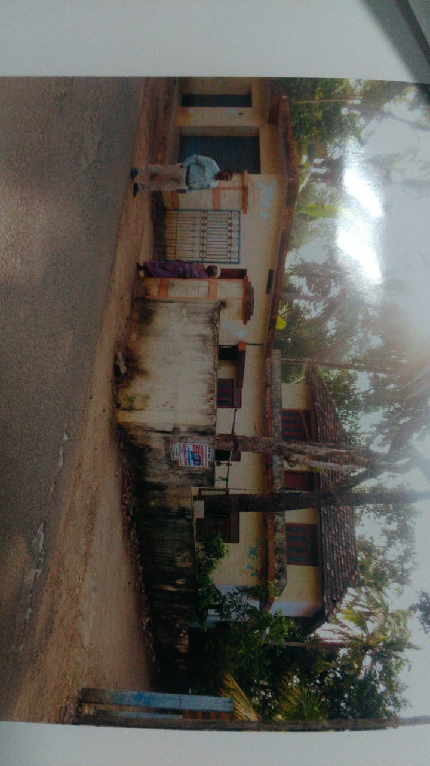
Residential Land & Building
RSEB - 167
Location of Property | THUCKALAY
Total area of land | 27.5 Cents
Constructed area | 1574 sq.fts.
Year of construction | 1976
Current market value | Rs. 38.50 lacs

Slide 18
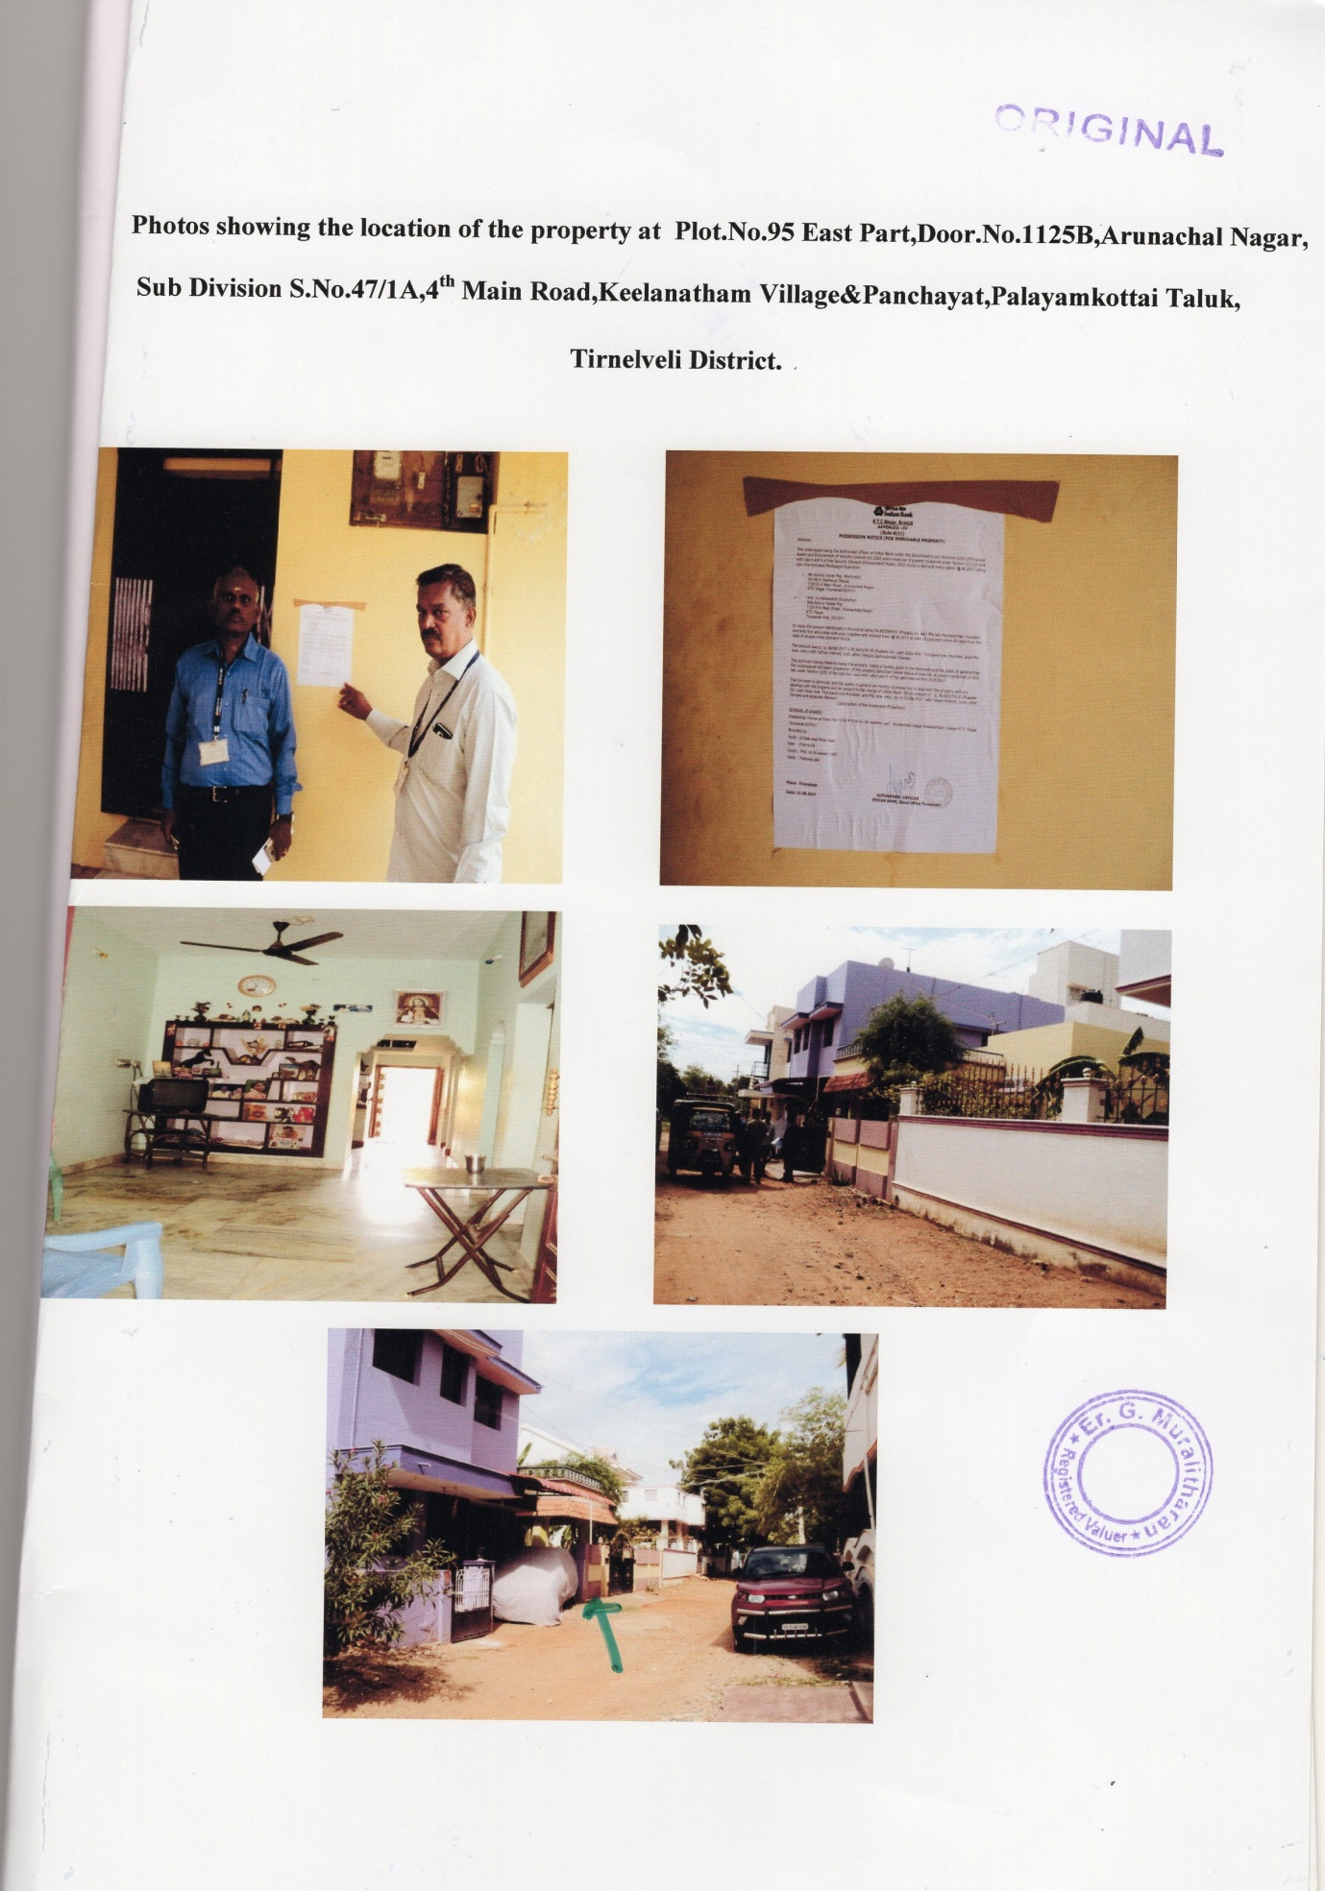
Residential Land & Building
RSEB - 168
Location of Property | KTC NAGAR
Total area of land | 1825.16 sq.fts
Constructed area | 954.77 sq.fts.
Year of construction | 2003
Current market value | Rs. 27.00 lacs

Slide 19
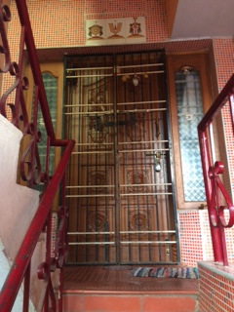
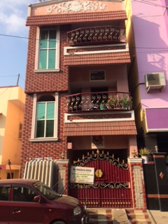
RESIDENTIAL BUILDING
RESB - 169
Location of Property | PURUSAWALKAM ,CHENNAI
Total area of land | UDS 411 sq.ft
Constructed area | FF- 546 sq.ft.
Year of construction | -----
Current market value | Rs.41.48 Lacs

Slide 20
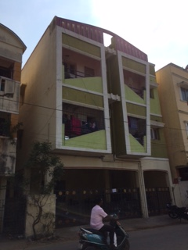
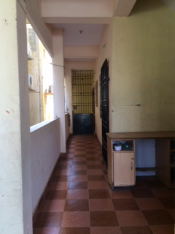
RESIDENTIAL BUILDING
RESB - 170
Location of Property | PURUSAWALKAM,CHENNAI
Total area of land | FLAT NO.1,SECOND FLOOR
Constructed area | UDS area is 363.90 sft. Out of 2415 sft.,,Plinth area is 830 sq.ft ,carpet area is 559 sft.,
Year of construction | -----
Current market value | Rs. 40.78 Lacs

Slide 21
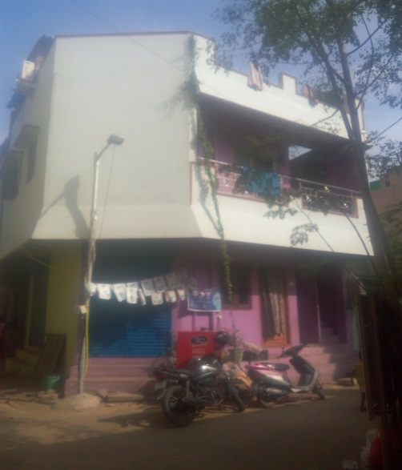
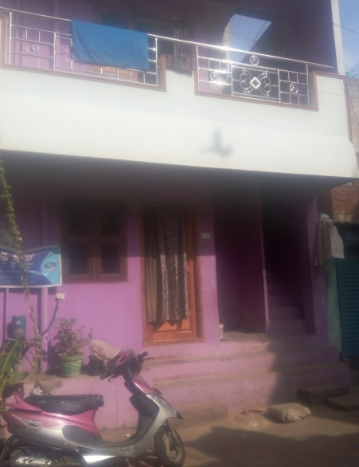
RESIDENTIAL BUILDING
RESB - 171
Location of Property | THONDAIRPET,CHENNAI
Total area of land | 401.00 sq.ft
Constructed area | First & Second Floor
Year of construction | -----
Current market value | Rs. 22.89 Lacs

Slide 22
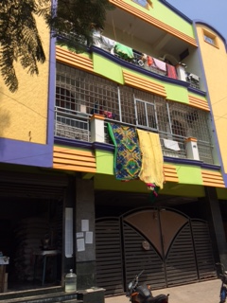
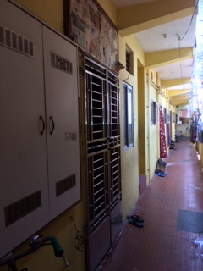
RESIDENTIAL BUILDING
RESB - 172
Location of Property | PURUSAWALKAM ,CHENNAI
Total area of land | UDS area 261
Constructed area | Plinth area is 657 sft., Carpet area is 496 sqft.
Year of construction | -----
Current market value | Rs.37.48 Lacs

Slide 23
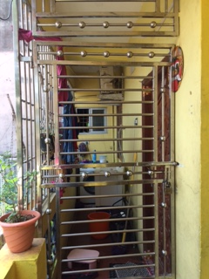

RESIDENTIAL BUILDING
RESB - 173
Location of Property | PURUSAWALKAM ,CHENNAI
Total area of land | UDS 230 sq.ft
Constructed area | Plinth area is 580 sq.ft., carpet area is 495 sq.ft
Year of construction | -----
Current market value | Rs. 34.42 Lacs

Slide 24
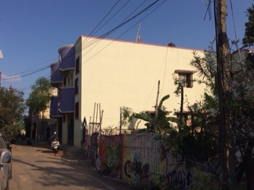
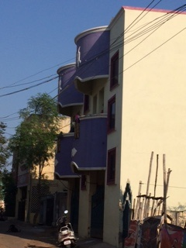
RESIDENTIAL BUILDING
RESB - 174
Location of Property | PONNIAMMANMEDU ,CHENNAI
Total area of land | UDS area is 419.63 sqft
Constructed area | FF- Plinth area is 660 sq.ft.,carpet 571 sq.ft .,
Year of construction | -----
Current market value | Rs.34.16 Lacs

Slide 25
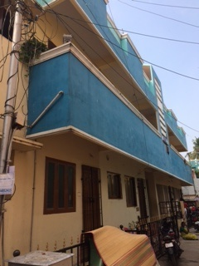
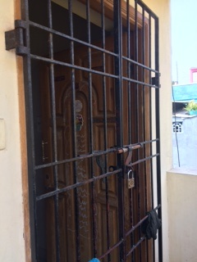
RESIDENTIAL BUILDING
RESB - 175
Location of Property | PERAMBUR ,CHENNAI
Total area of land | UDS area 254.92 sft
Constructed area | GF- Plinth area is 542 sft., carpet 314 sft
Year of construction | -----
Current market value | Rs. 21.30 Lacs

Slide 26
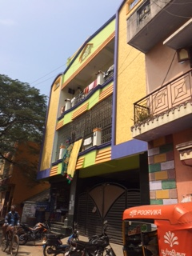
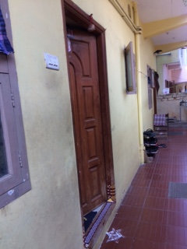
RESIDENTIAL BUILDING
RESB - 176
Location of Property | PERAMBUR ,CHENNAI
Total area of land | UDS 264 sqft
Constructed area | FF- Plinth area is 668 sft.,carpet area is 495 sqft.,
Year of construction | -----
Current market value | Rs. 37.62 Lacs

Slide 27
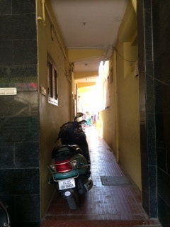
RESIDENTIAL BUILDING
RESB - 177
Location of Property | PERAMBUR ,CHENNAI
Total area of land | UDS 233 sq.ft
Constructed area | GF-Plinth 588 sft., carpet area is 546 sft.,
Year of construction | -----
Current market value | Rs. 32.08 Lacs

Slide 28
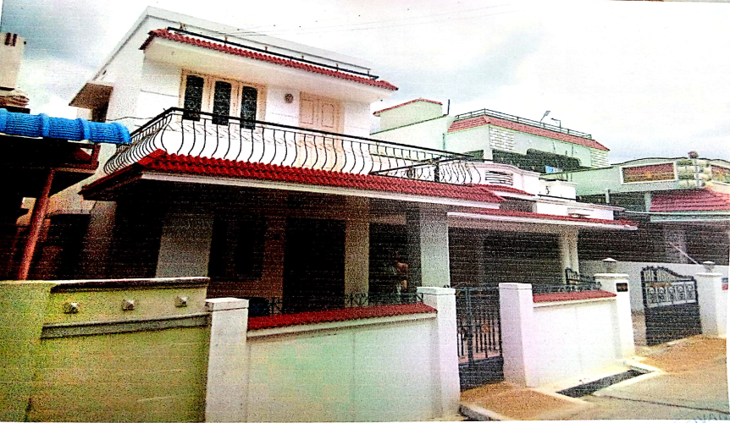
RESIDENTIAL BUILDING
RESB - 178
Location of Property | METTUPALAYAM,COIMBATORE
Total area of land | 2784 sq.ft
Constructed area | ------
Year of construction | -----
Current market value | Rs. 54.80 Lacs

Slide 29
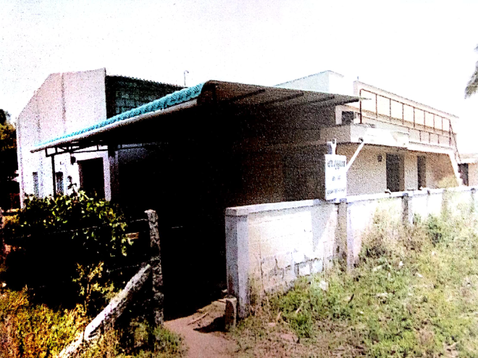
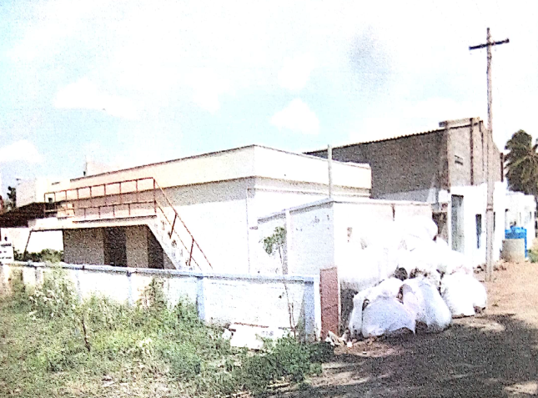
RESIDENTIAL BUILDING
RESB - 179
Location of Property | METTUPALAYAM,COIMBATORE
Total area of land | 4550 sq.ft
Constructed area | ------
Year of construction | -----
Current market value | Rs. 29.25 Lacs

Slide 30
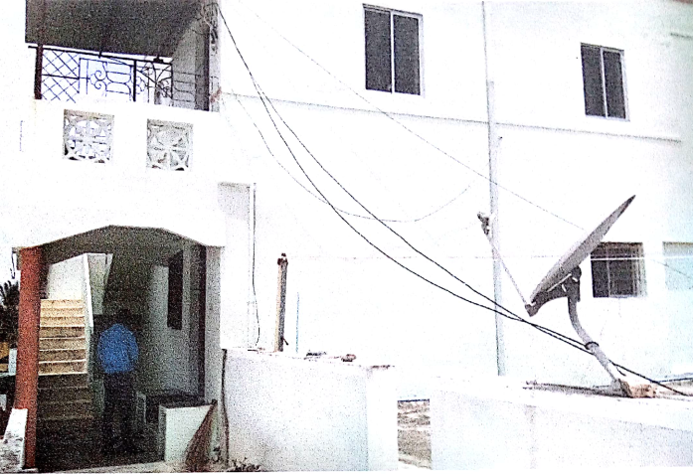
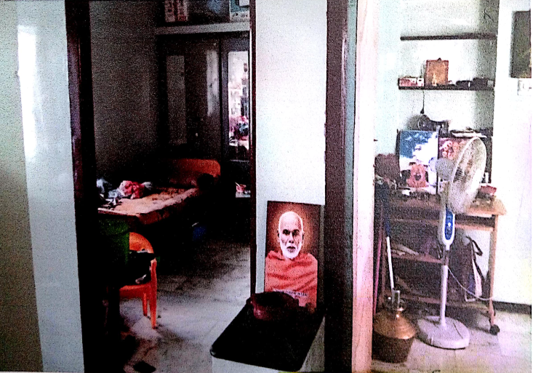
RESIDENTIAL BUILDING
RESB - 180
Location of Property | METTUPALAYAM,COIMBATORE
Total area of land | 995.00 sq.ft
Constructed area | ------
Year of construction | -----
Current market value | Rs. 46.10 Lacs

Slide 31
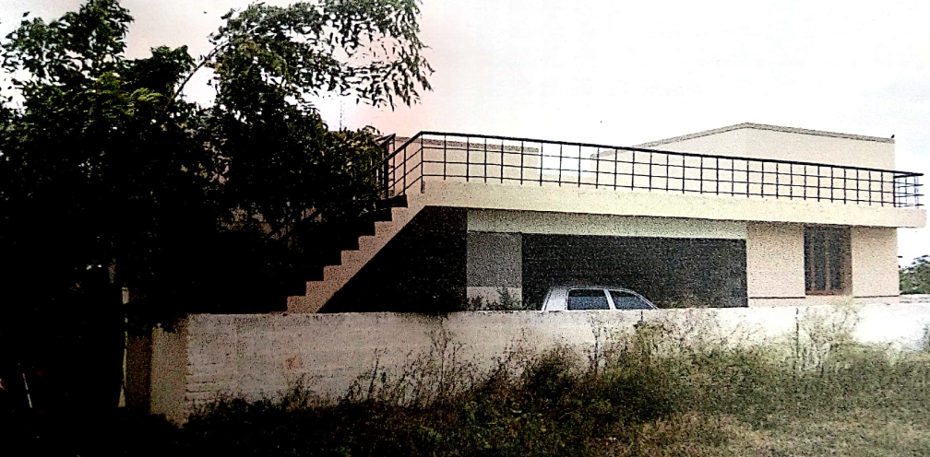
RESIDENTIAL BUILDING
RESB - 181
Location of Property | KALAPATTI,COIMBATORE
Total area of land | 1950.00 sq.ft
Constructed area | ------
Year of construction | -----
Current market value | Rs.51.10 Lacs

Slide 32
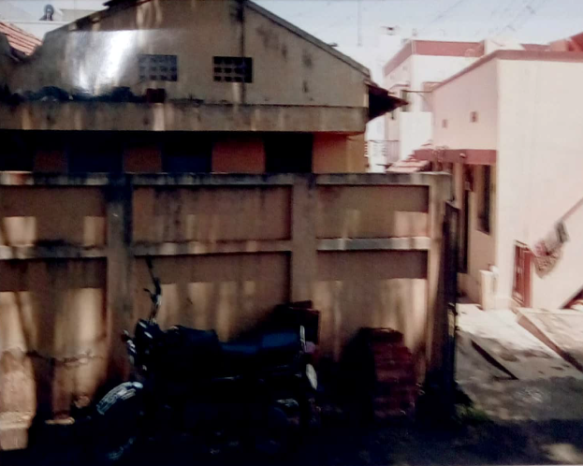
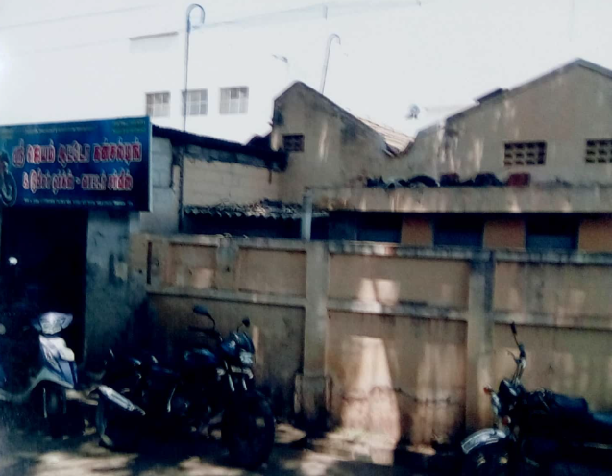
RESIDENTIAL BUILDING
RESB - 182
Location of Property | SUNDARAPURAM,COIMBATORE
Total area of land | 2484.80 sq.ft
Constructed area | ------
Year of construction | -----
Current market value | Rs.191.41 Lacs

Slide 33
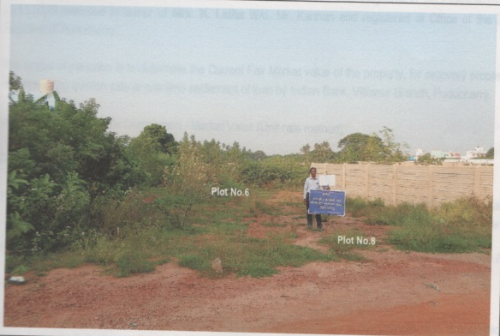

RESIDENTIAL LAND
RESB - 183
Location of Property | ARIYANKUPPAM,PONDICHERRY
Total area of land | 4859 sq.ft
Constructed area | NA
Year of construction | NA
Current market value | Rs.21.57 Lacs

Slide 34


RESIDENTIAL BUILDING
RSEB - 184
Location of Property | KOLAPAKKAM GUDUVANCHERRY
Total area of land | 3381.Sq ft
Constructed area | Ground floor –1085 Sq.ft. UDS 548sq.ft
Year of construction
Current market value | Rs. 41.85 lacs

Slide 35


RESIDENTIAL BUILDING
RESB-185
Location of Property | ARUMPARTHAPURAM,PUDUCHERRY
Total area of land | 1087 sq.ft
Constructed area | 1087 sq.ft
Year of construction | 2008
Current market value | Rs. 34.85 Lacs

Slide 36


RESIDENTIAL BUILDING
RESB- 186
Location of Property | G N PALAYAM,PUDUCHERRY
Total area of land | 144 sq.meter
Constructed area | 1st FLOOR 83.97 sq.meter,2nd FLOOR 85.36 sq.meter
Year of construction | ---
Current market value | Rs. 55.43 Lacs

Slide 37


Commercial Land & Building v
RESB-187
Location of Property | SALEM
Total area of land | 3384 sq.fts
Constructed area | 2753
Year of construction | 2002
Current market value | Rs. 159.90 lacs

Slide 38

Residential Land & Building
RSEB-188
Location of Property | CHINNAMANALI, SALEM
Total area of land | 4597 sq.fts
Constructed area | 3000 sq.fts.
Year of construction | 2008
Current market value | Rs. 40.91 lacs

Slide 39

Residential Land & Building
RSEB-189
Location of Property | GUNDALADUVU, SALEM
Total area of land | 1281 sq.fts
Constructed area | 1281 sq.fts.
Year of construction | 2006
Current market value | Rs. 6.00 lacs

Slide 40


Residential Land & Building
RSEB-190
Location of Property | PAPPIREDDIPATTY, SALEM
Total area of land | 1657 sq.fts
Constructed area | 1657 sq.fts
Year of construction | 2012
Current market value | Rs. 36.96 lacs

Slide 41


Residential Land & Buildind
RSEB-191
Location of Property | METTUR, SALEM
Total area of land | 506 sq.fts
Constructed area | 506 sq.fts
Year of construction | 2005
Current market value | Rs. 6.45 lacs

Slide 42
Residential Land & Building
RSEB-192
Location of Property | THUCKALAY
Total area of land | 27.5 Cents
Constructed area | 1574 sq.fts.
Year of construction | 1976
Current market value | Rs. 38.50 lacs

Slide 43



RESIDENTIAL FLAT
RESB-193
Location of Property | Valar Nagar, Madurai
Total area of land | 1868 Sq.ft
Constructed area | 1868 Sq.ft
Year of construction | 2012 - 13
Current market value | Rs. 49.42 lacs

Slide 44


RESIDENTIAL BUILDING
RESB-194
Location of Property | North Masi St., Madurai
Total area of land | 373 sq. ft.
Constructed area
Year of construction | 2001
Current market value | Rs. 39.41 lacs

Slide 45

RESIDENTIAL LAND & BUILDING
RESB-195
Location of Property | MORAPPUR,DHARMAPURI
Total area of land | 1500 Sq.ft
Constructed area | Ground Floor & First Floor- 1579.50sq.ft
Year of construction | 2012
Current market value | Rs. 26.90 lacs

Slide 46

RESIDENTIAL LAND & BUILDING
RESB-196
Location of Property | PALACODE,DHARMAPURI
Total area of land | Sq.ft
Constructed area | Ground Floor & First Floor- sq.ft
Year of construction
Current market value | Rs. lacs

Slide 47



RESIDENTIAL BUILDING
RESB-197
Location of Property | Madurai- Annam Metals
Total area of land | 1034.31 sq.ft
Constructed area | 1000 sq ft
Year of construction | 2014
Current market value | Rs 40 lakhs
Sale value | Rs 37 lakhs

Slide 48


Residential Building
RESB-198
Location of Property | Tirunelveli - Palayamkottai
Total area of land | 3210 sq ft
Constructed area | 843 sq ft
Year of construction | 1994
Current market value | Rs 67.15 lakhs
Sale value | Rs 60.44 lakhs

Slide 49


Residential Building
RESB-199
Location of Property | Madurai- Anayur- S Alangulam
Total area of land | 7302.25 sq ft
Constructed area | 3755 sq ft
Year of construction | 2002,2005 and 2010
Current market value | Rs 219.96 lakhs
Sale value | Rs 197.96 lakhs

Slide 50


Residential Building
RESB-200
Location of Property | Sivakasi- Virudhunagar
Total area of land | 1396.50 sq ft
Constructed area | 110 sq m (GF)+21 sq m FF
Year of construction | 2007
Current market value | Rs 33.77 lakhs
Sale value | Rs 30.70 lakhs

